Slide 1
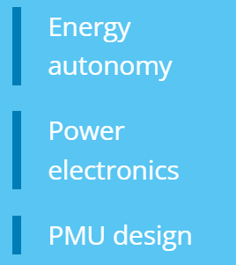
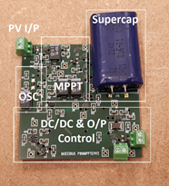
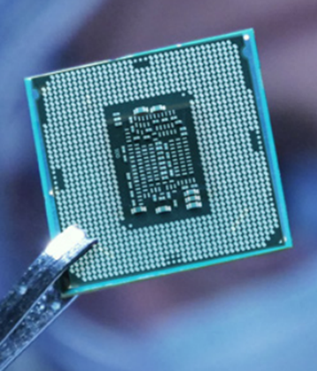
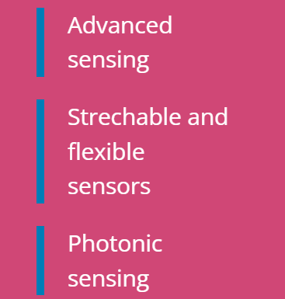
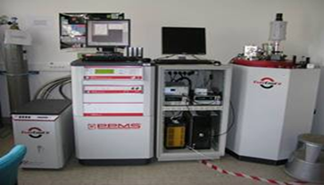
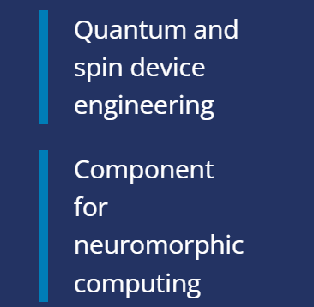
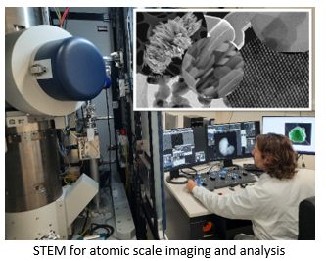
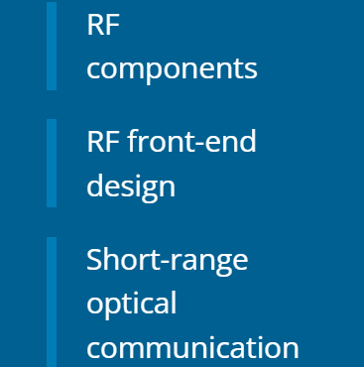
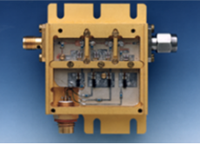
INFRASTRUCTURE for Emerging and Responsible Electronics
INFRACHIP aims at implementing the first integrated, distributed research infrastructure as a wider European research platform for the sustainable development of next-generation and future semiconductor chips.
WHY? Access to various technologies is not equal for all and this can be a game changer in terms of innovation. By removing these barriers, INFRACHIP aims at boosting research and innovation.
HOW? INFRACHIP offers short focused access projects including the possibility to welcome you at the facilities of one of our access providers. Depending on the task and your own competence, the work will be performed together with our local expert.
Non volatile memories
Green Electronics & Substrates
Green Sensors
Hybrid SiP/SoC
www.infrachip.eu

